Slide 1
Reg Rotator Proposal
By Victor Perez and Jon Montesano

Slide 2
Scenario
When it comes to college radio, music directors use a system to ensure that that the collection of recent releases played on air get a somewhat equal amount of air time. Albums are separated into the following rankings: Hots, Mediums, Lights and A-Picks. Disc jockeys pick a certain amount of songs from each category, and the albums those songs are on are sent to the back of the queue. This system is called “regular rotation,” and, at U92, this is all done using paper cards and sheets. A digitized version of this would be helpful for many college radio stations across the country.

Slide 3
Album
An Album is a singular collection of music released by an artist. Every album contains multiple songs. Because our radio station does not accept “Singles,” all albums must contain at least 4 songs. An album is the primary entity in the database and is what rotation focuses on. Every album is placed into one of the 4 categories outlined in the scenario.
Essential Attributes: Album ID, Album Title, Release Date, Category, Date Added (to rotation), X tracks (music director picks), Description, Rotation Status?, RIYL (helper table)
Relationships: Song - 1:N

Slide 4
Artist
An Artist is the creator of an album, EP, or other, self-contained collection of music. Artist is the second highest level entity in the database. Artists can have multiple albums, and there can be multiple artists on a single album.
Essential Attributes: Artist ID, Artist Name, City, State, Country, Debut Date, Genre (IDv3 metadata)
Relationships: Album - M:N, 1:N

Slide 5
Song
A song is one of the many pieces that make up an album. Once chosen by a disc jockey, the date the song is played is marked down on a playlist, and the album the song is on is sent to the back of the queue. Songs must be linked to an album.
Essential Attributes: Song ID, Song Name, Artist Name, Track Number, Length, Request Flag, X/D Pick Flag, Album_ID, Explicit?
Relationships: Artist - N:M, Album - 1:N

Slide 6
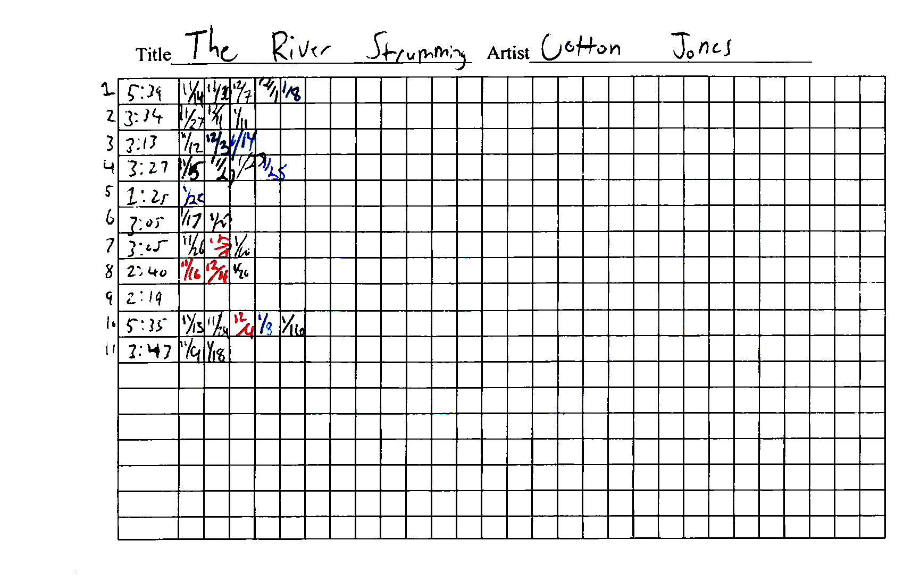
Album Card

Slide 7
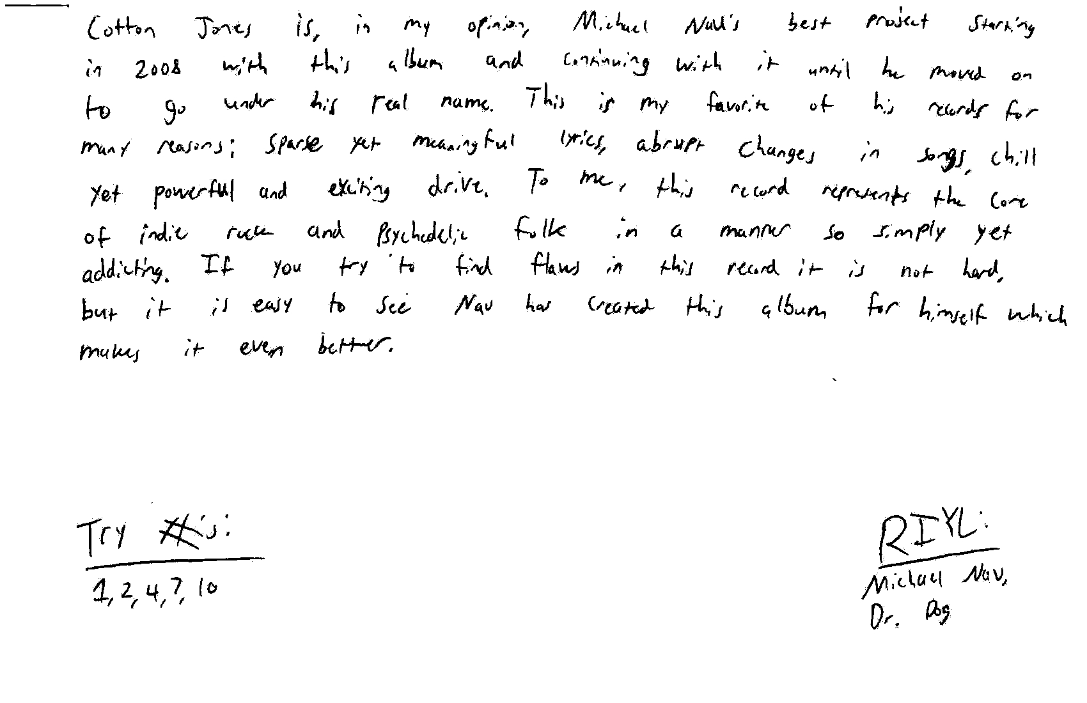
Album Card

Slide 8
Playlist
A Playlist is a list, recorded by a DJ during their shift, of songs played during each hour. The playlist is structured by the categories outlined in the scenario. For the purposes of this system, D-Picks and X-Picks will not be stored in any location other than the Playlist as plain text (and these songs will also have no attributes, as they are not entities).
Essential Attributes: Playlist ID, DJ Name, Date, Time, Song Selections (helper table)
Relationships: Song - 1:N

Slide 9
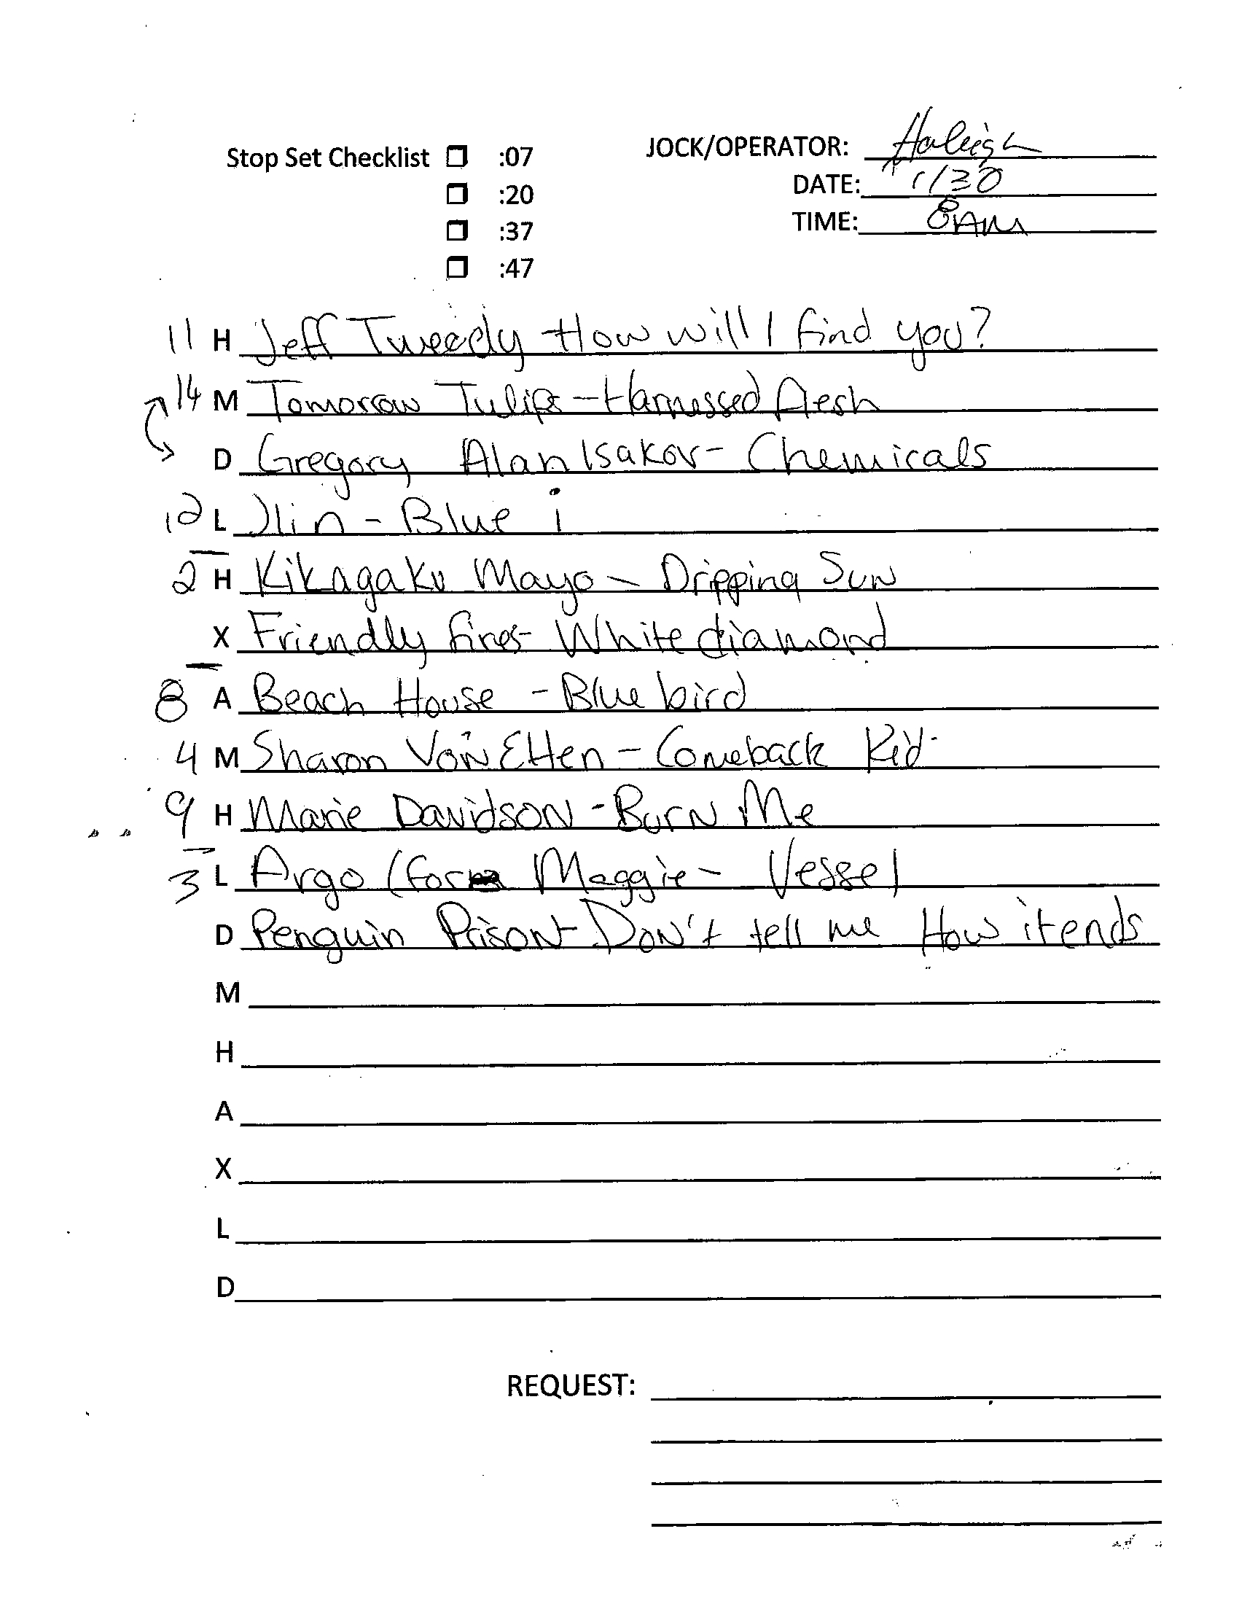
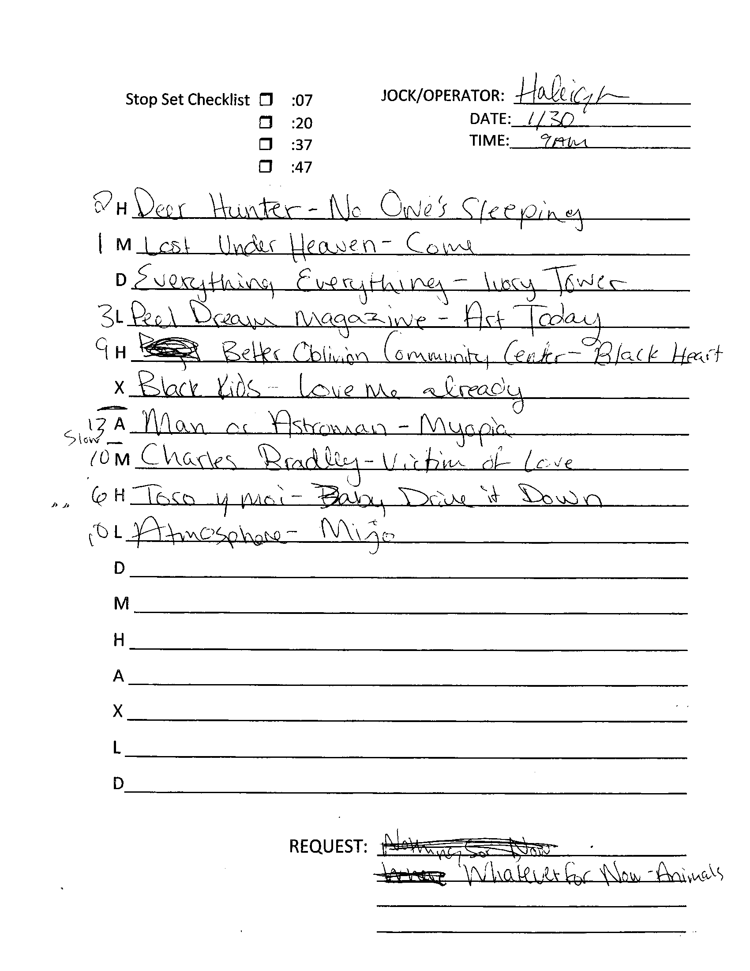
Playlist Sheet

Slide 10
Prototype
Reg Rotator will be a web application designed to allow radio stations a means of keeping their music rotation records digitally.
To achieve this, we must provide a UI with all functions that are present on our current paper medium. We must also provide a database that allows DJs to view what albums are currently in rotation, as well as what has been in rotation in the past. This database should be easy to filter and search through.
The target users of this project will be college radio stations, and specifically DJs & music directors at those stations. These users will not be represented as entities.

Slide 11
Tech Stack
MySQL will be used for the database
Express will route the back end to front-end
React.js for advanced front-end if time permits
Node.js to run the back-end

Slide 12
Roles
Victor Perez - Front-End engineer
Jon Montesano - Back-End engineer
Both members will work on the database cooperatively
As for leadership, both members will work in cooperation, making decisions mutually and unanimously.

